Slide 1



AWS STUDENT BUILDER GROUP
EGERTON UNIVERSITY
PRESENTS
Cloud Security
AWS IAM
week
4
CLOUD
FORGE
Ephy Kimotho
4h July 2026
#AwsStudentbuilders

Slide 2







intro
Table of contents
INTRODUCTION TO IAM
IAM Terminologies
Shared responsibility model
Security using NACLs and Security Groups
Authentication & Authorization
Principle of Least Privilege & MFA
#AwsStudentbuilders

Slide 3

WHAT IS IAM ?
Cloud security is very important as it provides guidelines for you to create your infrastructure and applications securely.
It includes activities such as securing components, encryption of data, Traffic inspecting and so much more.
Cloud security is a shared responsibility between AWS and their customers as we will see in the shared responsibility model. AWS is responsible for protecting it’s global infrastructure and the customer is responsible for protecting resources in the cloud. IAM is one way of doing this.
IAM stands for Identity and Access Management. It’s a free service that allows you to govern users who can access your account and what they can access.
#AwsStudentbuilders

Slide 4
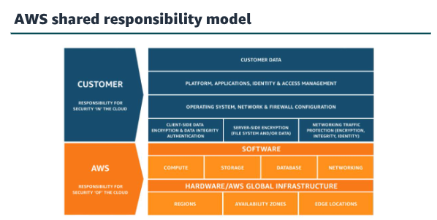
Shared responsibility model
#AwsStudentbuilders

Slide 5
Principle OF LEAST PRIVILEDGE & MFA
One best practice of cloud security is the principle of least privilege. It states that you should only grant the necessary permissions needed by an entity or resource to perform an action.
It’s more secure to start with a minimum set of permissions and grant additional permissions later on as needed.
IAM also support Multi-Factor Authentication MFA. MFA is a security process that requires more than just a password to access an account or system. It verifies your identity using at least two different methods, such as a code sent to your phone.
IF MFA is enabled an IAM user attempts to login they will be prompted for an auth code, This is delivered to an MFA device For example Google Authenticator.
#AwsStudentbuilders

Slide 6
IAM terminologies
IAM User: A person or application that can authenticate to an AWS account and interact with AWS resources and services. A user is given permanent credentials which stay with the user until a forced rotation occurs.
IAM Group: A collectionof IAM users who share a given set of permissions.
IAM Role: A set of temporary permissions that is granted to AWS resources to perform a given task. You can think of an IAM role as a container for polices.
IAM Policy: This a JSON document that defines the rules that determine who can do what within an AWS account. A Policy can be attached to a user, role, group.
#AwsStudentbuilders

Slide 7
TYPES OF POLICIES
Identity Based Polices: which are attached to an IAM user, role or group and they indicate what an IAM identity is allowed to do.
Resource Based Policies: which are attached to a resource i.e an S3 bucket and indicate what a given user is allowed to do within that resource.
Polices are evaluted whenever a request comes in in the following format shown in the next slide
#AwsStudentbuilders

Slide 8
POLICY EXAMPLE
{
"Version": "2012-10-17",
"Statement": [
{
"Sid": "AllowS3ReadAccess",
"Effect": "Allow",
"Action": [
"s3:GetObject",
"s3:ListBucket"
],
"Resource": "arn:aws:s3:::my-example-bucket/*"
} ] }
#AwsStudentbuilders

Slide 9
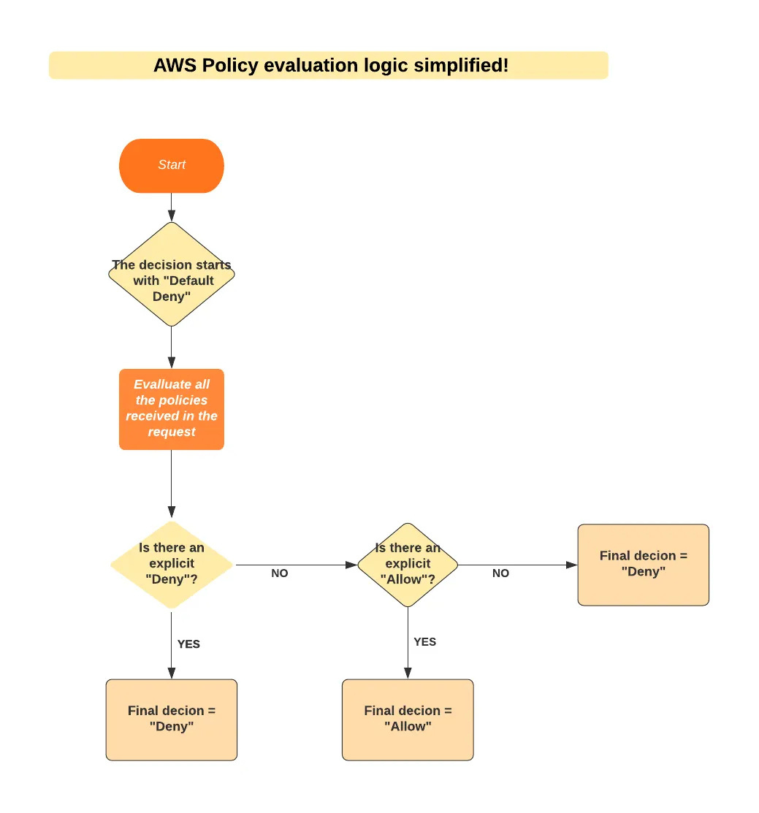

Slide 10
AWS STUDENT BUILDER GROUP
EGERTON UNIVERSITY
Any
questions??
week
4
CLOUD
FORGE
Ephy Kimotho
4th July 2026
#AwsStudentbuilders

